Slide 1
Far Eastern Inter-regional organization of persons with disabilities
“Kovcheg” (“The Arch”)
Reaching the impossible
2000-2012

Slide 2
Our mission
Is to help our fellows with disabilities to overcome their medical condition by improving the quality of their lives and by providing them with a free help, information and legal support.

Slide 3
Organization facts:
It is one of the most active and efficient organizations of persons with disabilities in Russia;
We focus on assistance to people in wheelchairs as one of the most challenged groups of people with disabilities;
Every month we organize social functions and sports-oriented events for different age groups and various categories of people with disabilities.

Slide 4
Our projects
and events

Slide 5
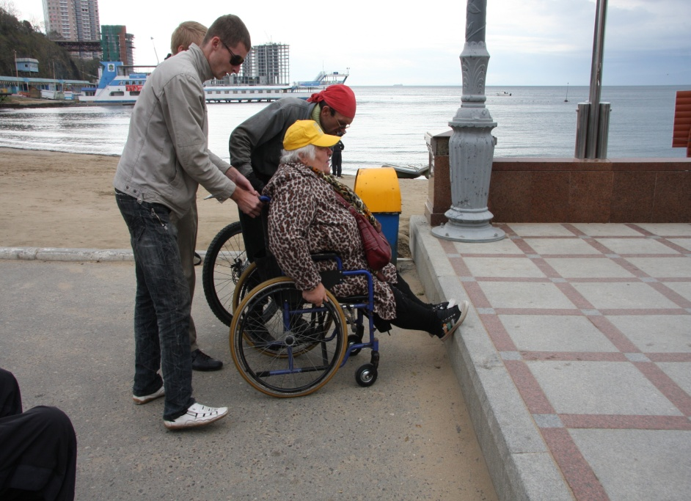
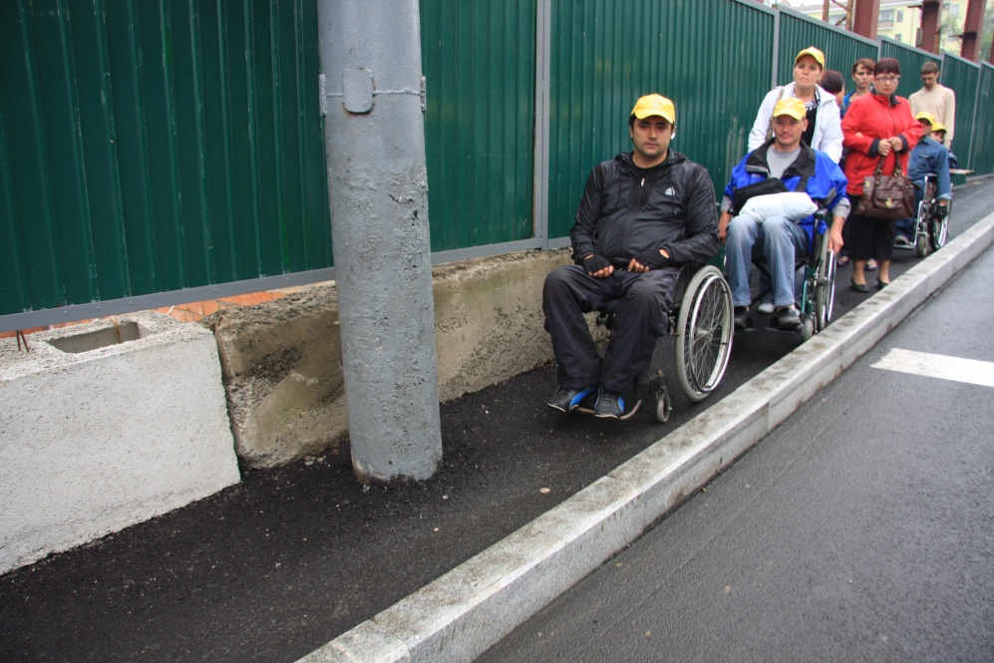
Projects that improve the quality of live of people with physical challenges
Providing a safe passage opportunities without obstacles to people in wheelchairs on the streets of the cities
Accessibility of city environment

Slide 6
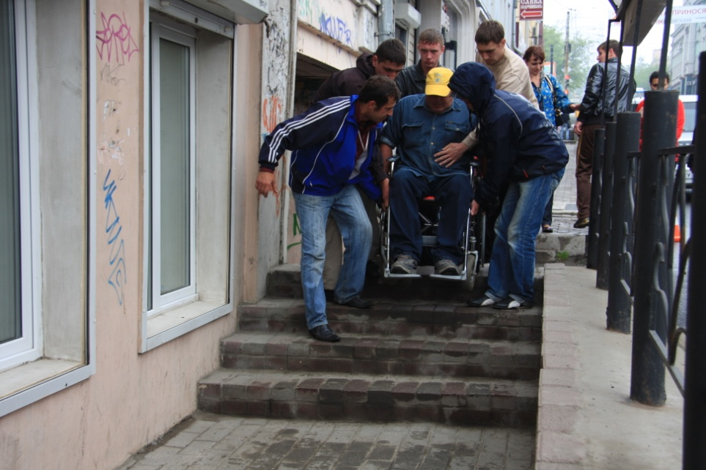
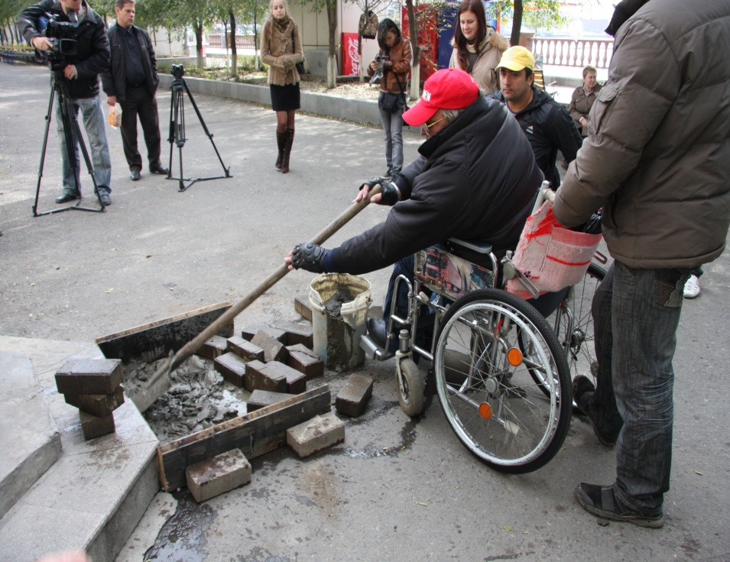
Equipping the streets of the city with the ramps that would be useful for people in wheelchairs.
Picture on the top: poor accessibility disables those in wheelchairs to travel without assistance from others.
Picture on the right: a person in wheelchair himself crashes a concrete structure that disables other physically challenged people to travel safely. Location: at the place that was recently renovated under government contract that did not feature accessibility for those in wheelchairs.

Slide 7
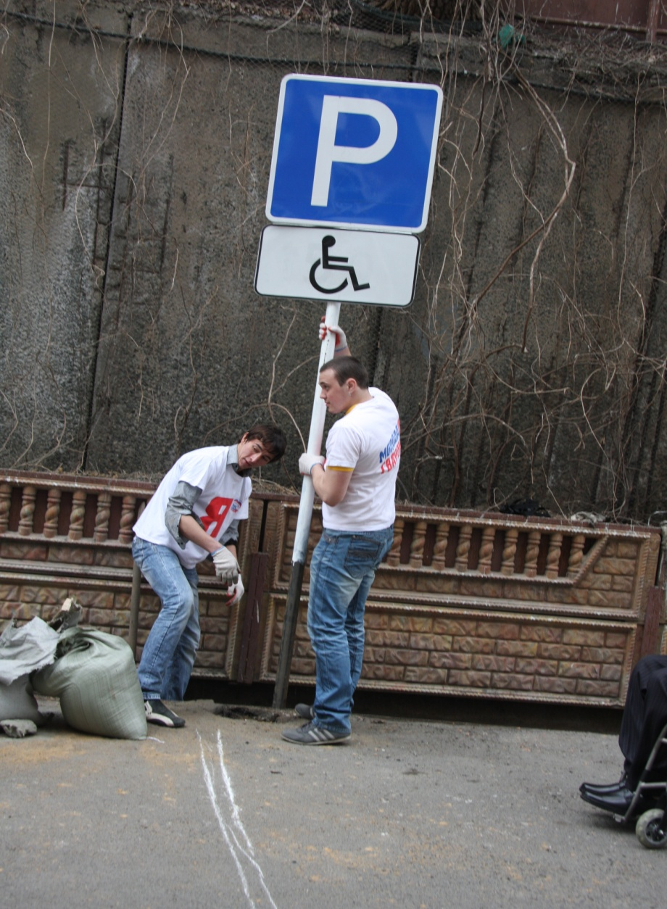
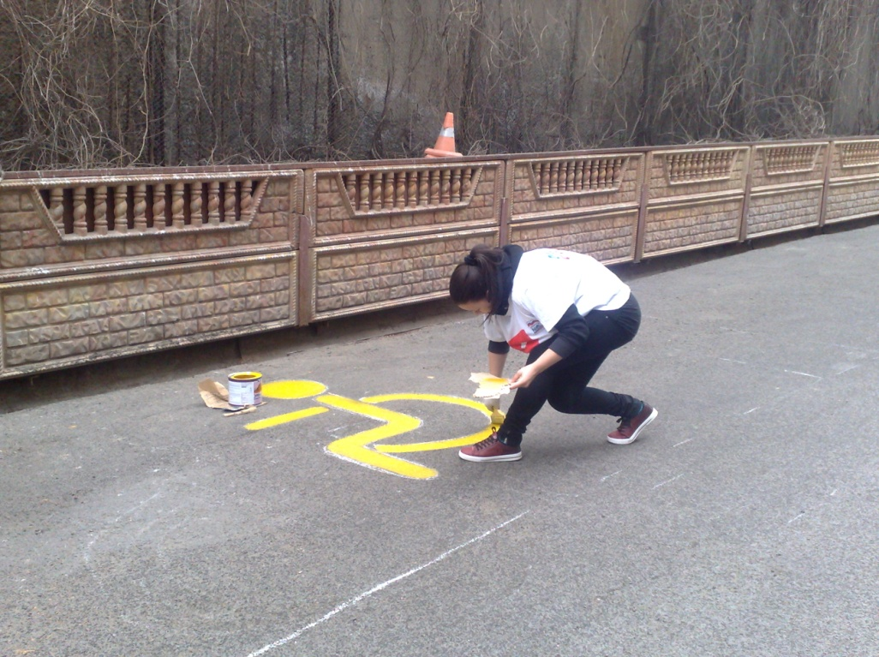
Parking lots for people with disabilities: a need for accessibility

Slide 8
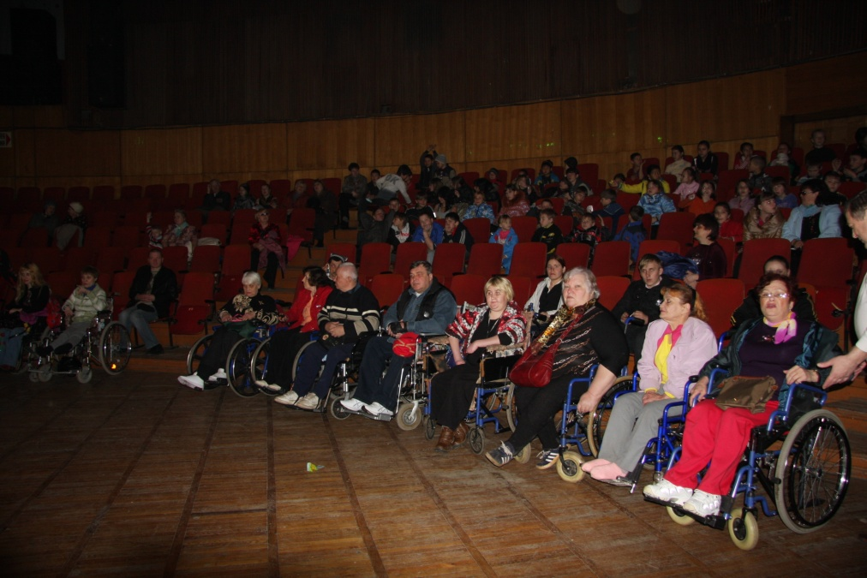
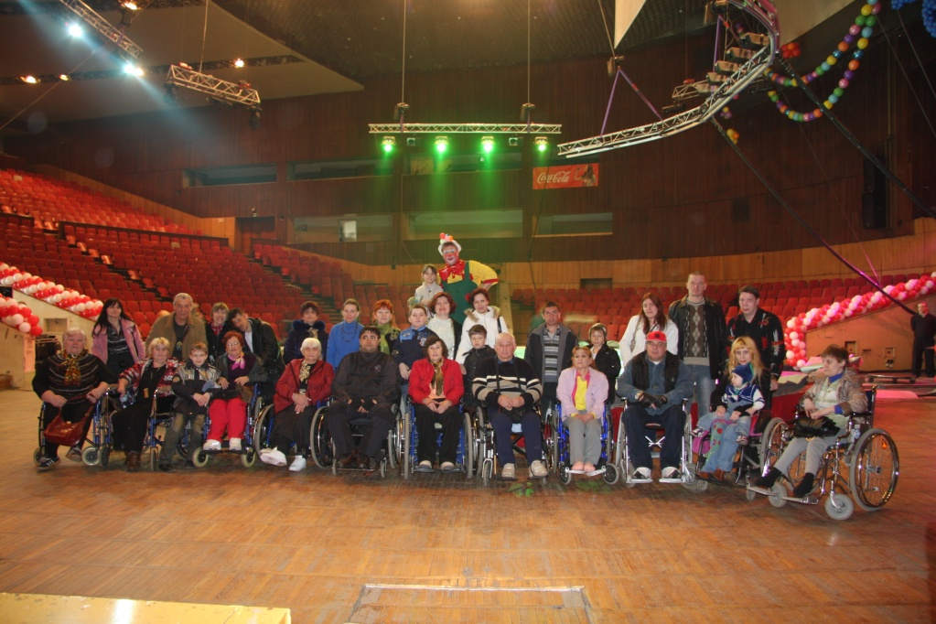
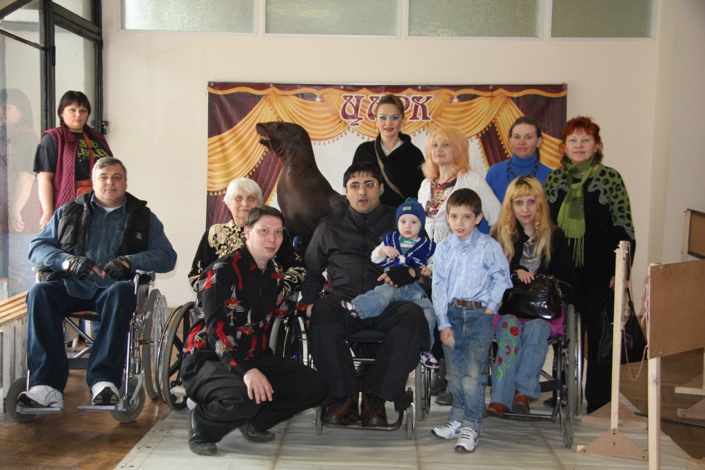
Group visits of people in wheelchairs of cultural events, cinemas, circuses and theatres.

Slide 9
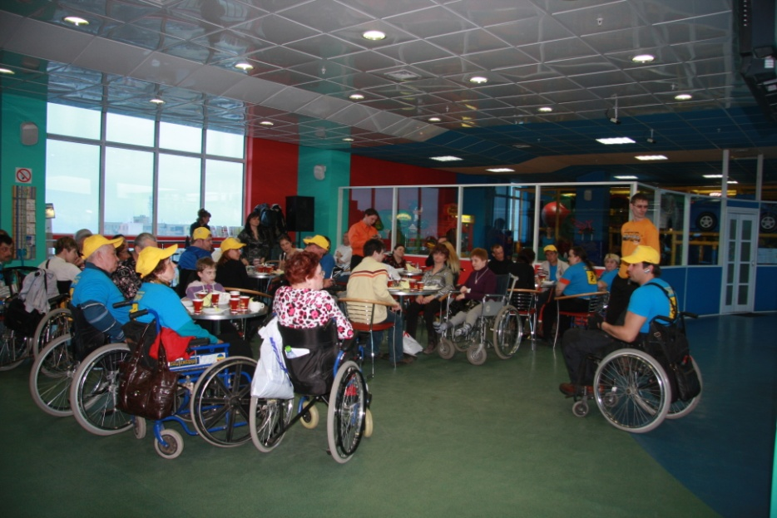
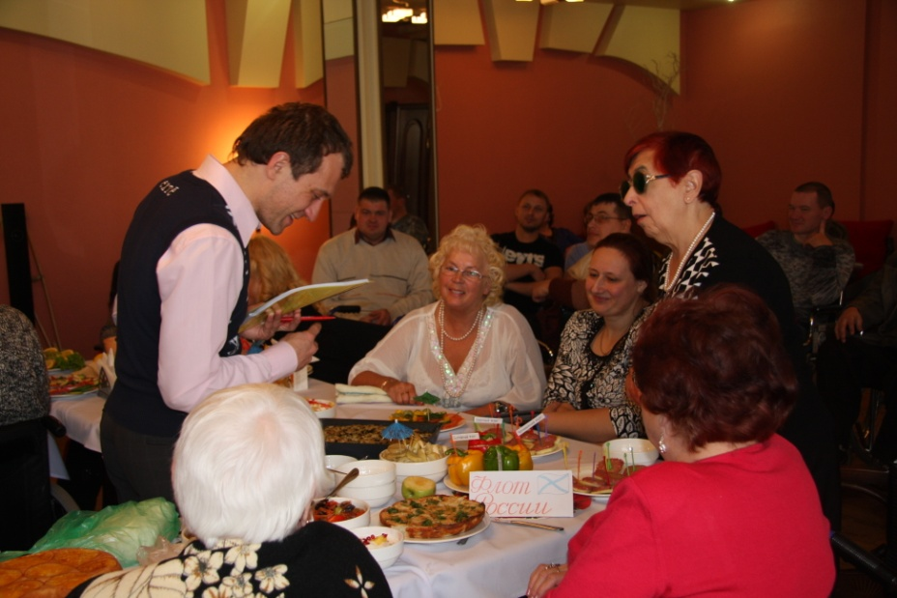
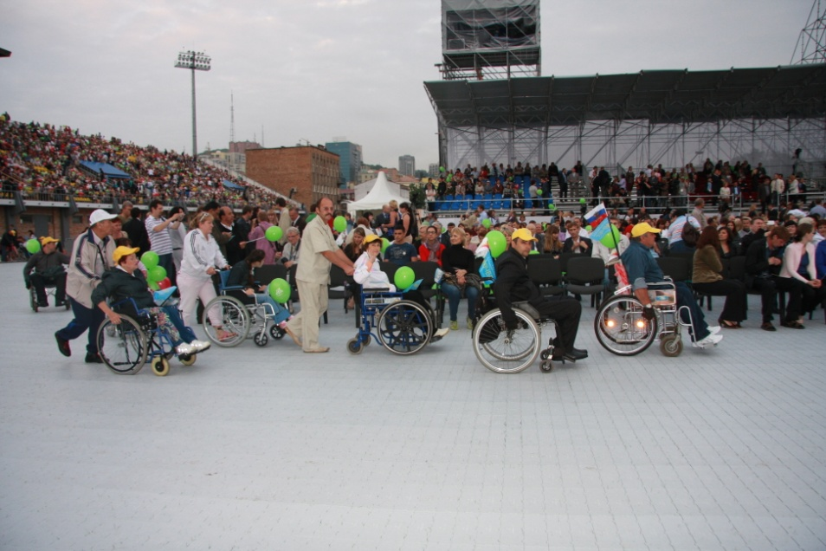
We offer people opportunities to meet, share impressions, and to enrich themselves both culturally and spiritually.

Slide 10
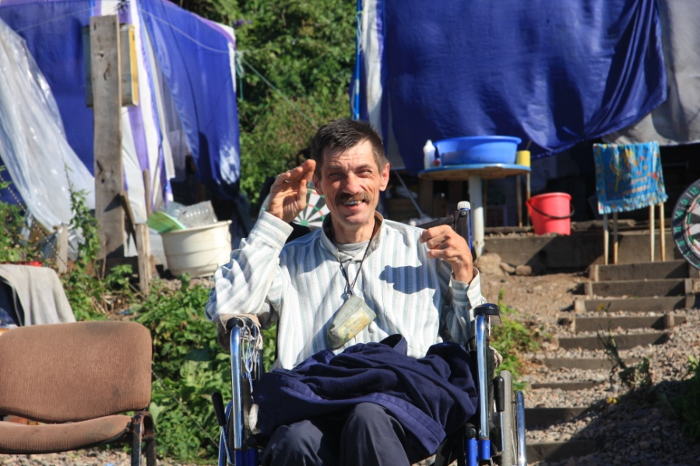
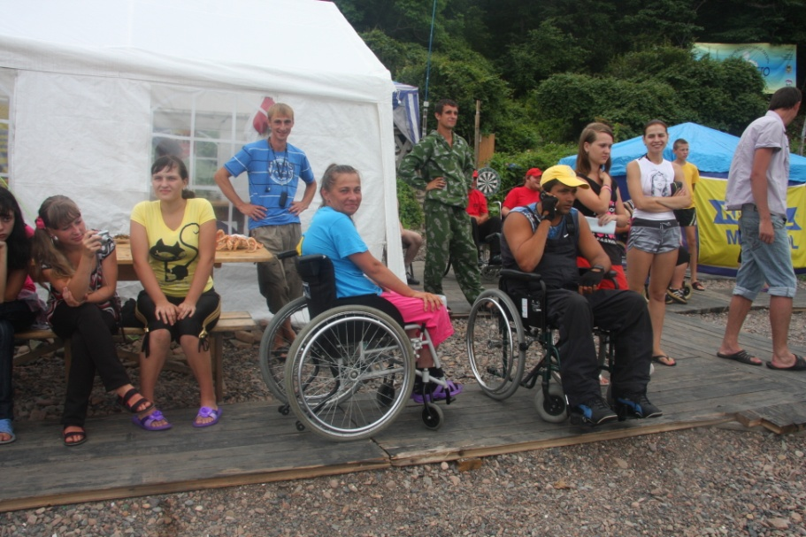
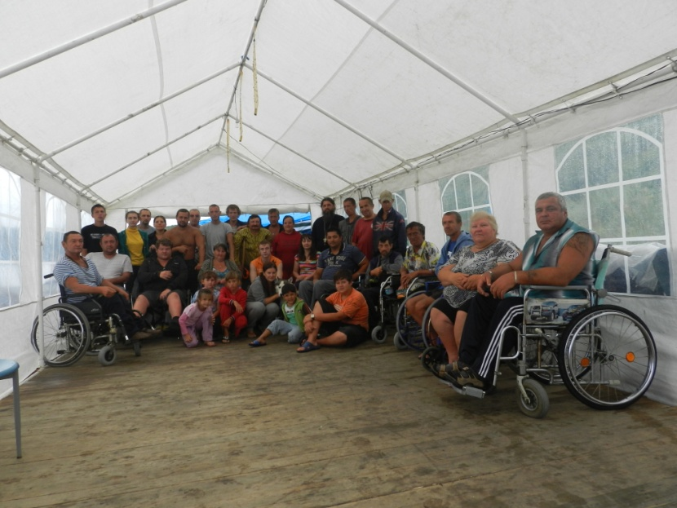
INVAsummer is a summer camp that is tailored for recreation, health improvement and finding new friends.

Slide 11
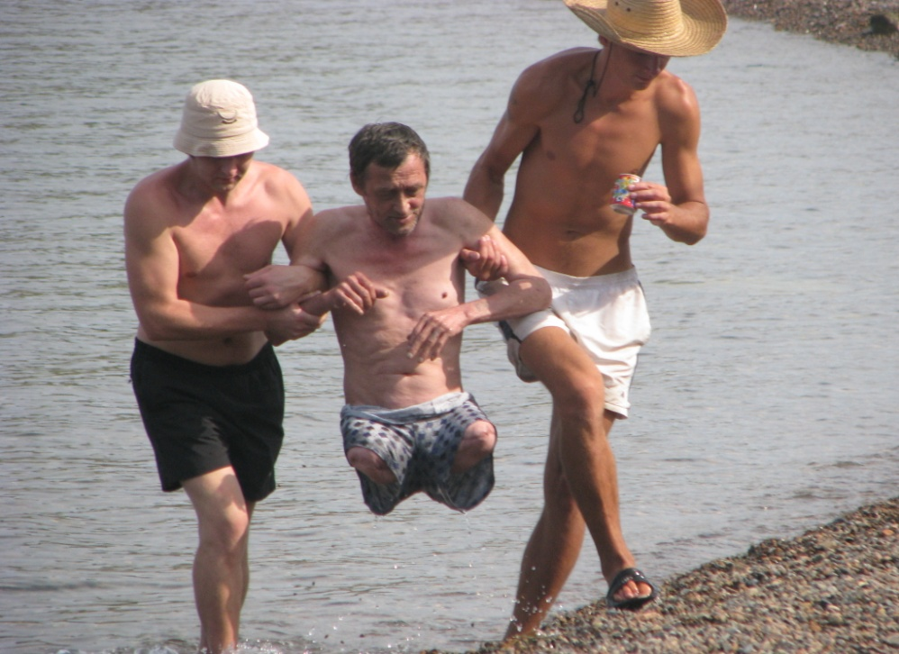
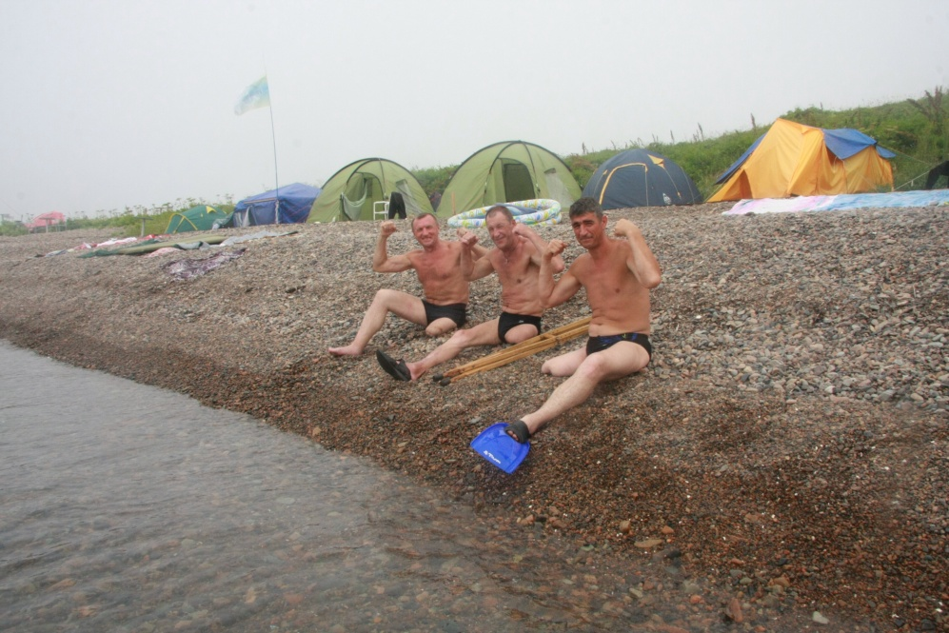
«The Sun, the Ocean and the Water are our best friends!» is the slogan for all those spending their time in the INVAsummer camp.

Slide 12
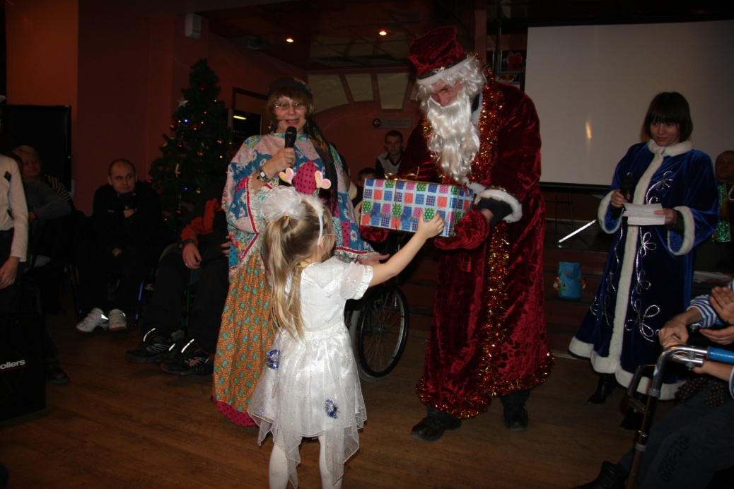
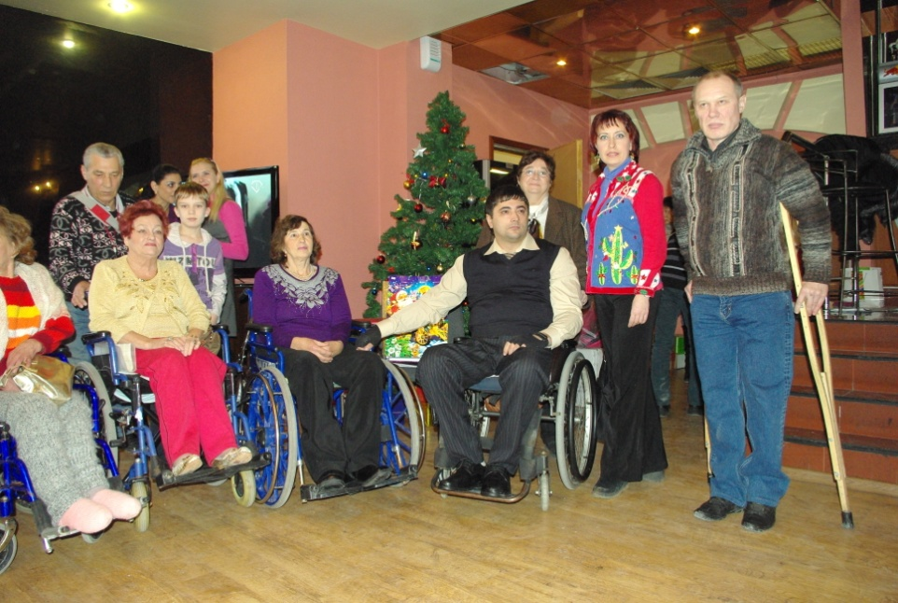
Celebrations for kids and adults in wheelchairs.

Slide 13
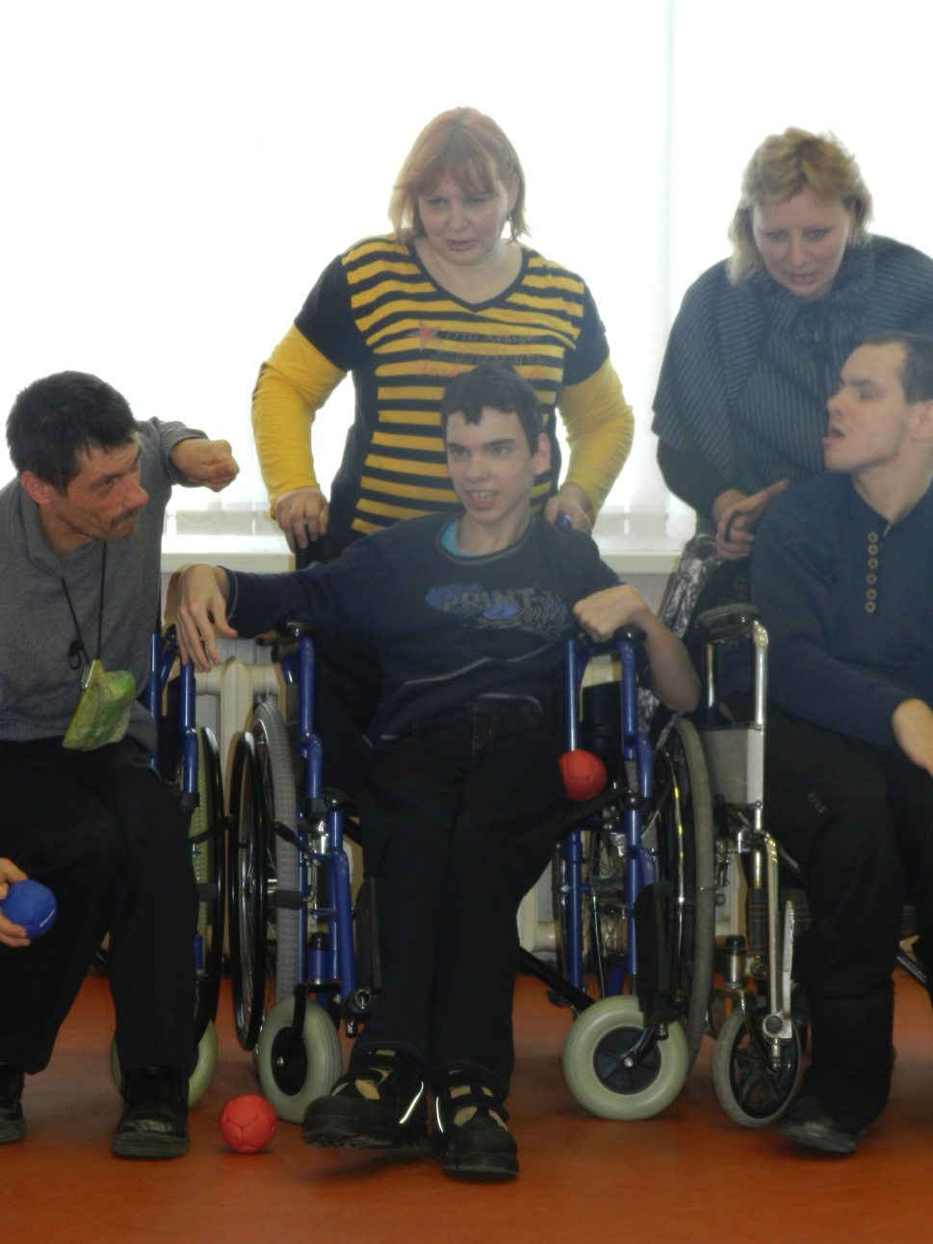
Winter holidays is the happiest time for everybody. This is the time when we expect miracles and happiness to happen.

Slide 14
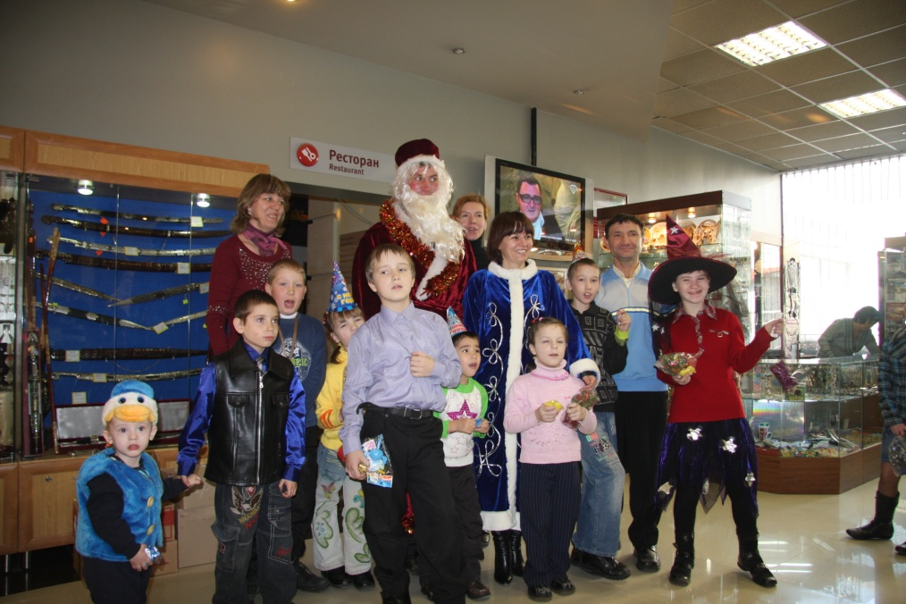
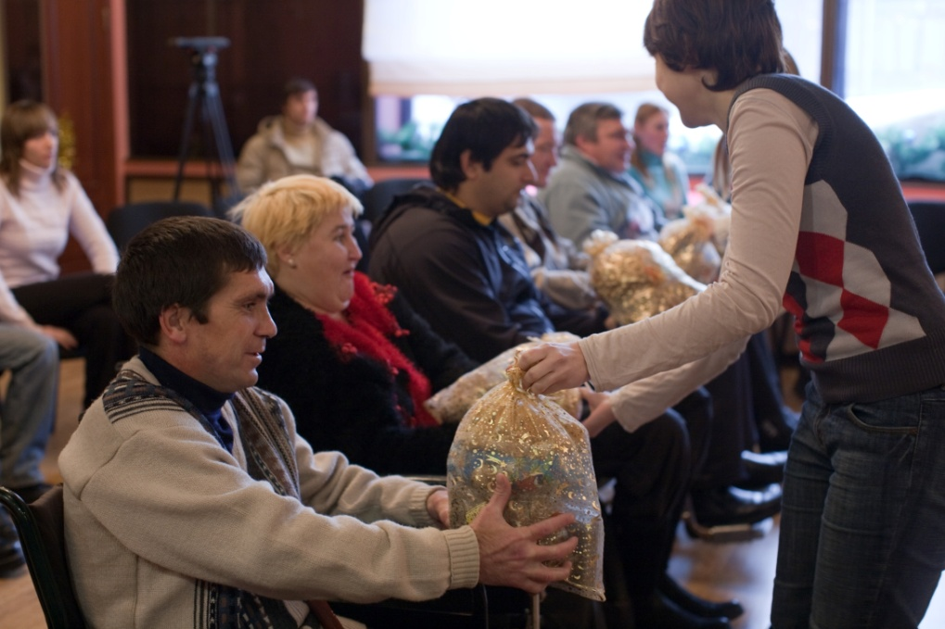
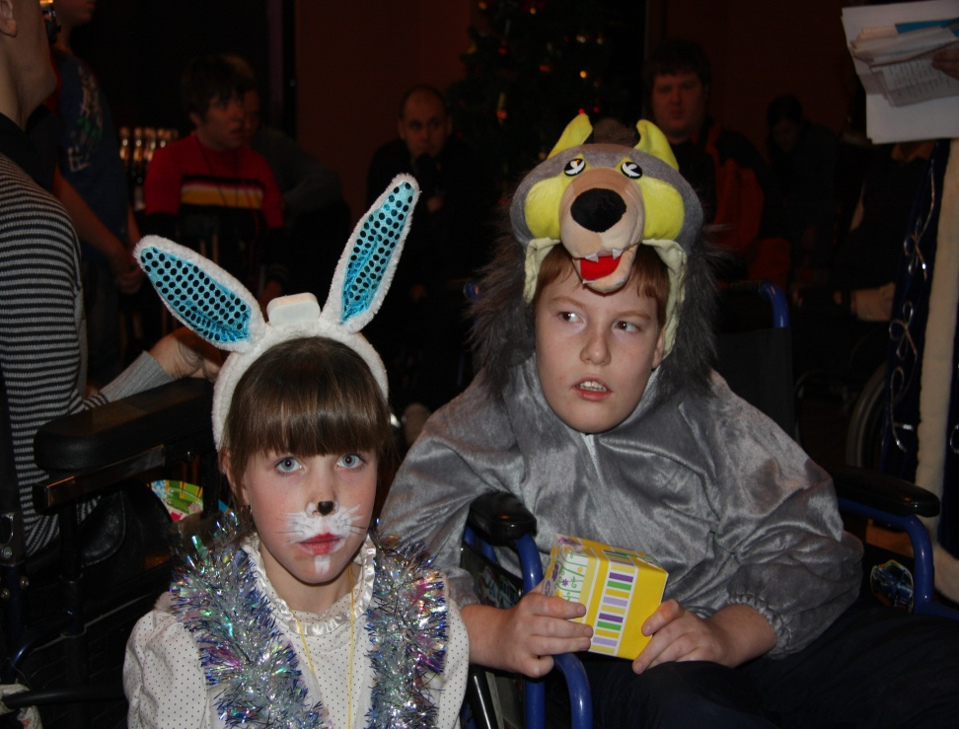
It is a great happiness to see the smiles of kids.

Slide 15
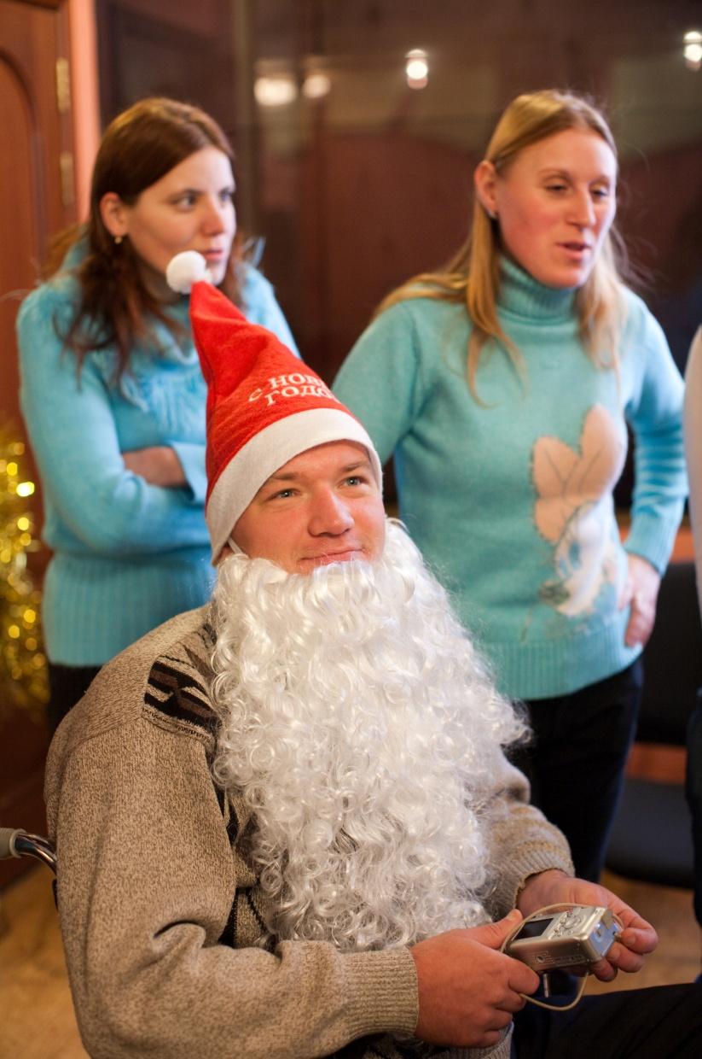
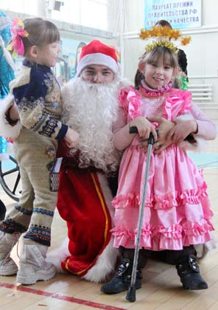
You can’t buy happiness.
But you can share it as a gift!

Slide 16
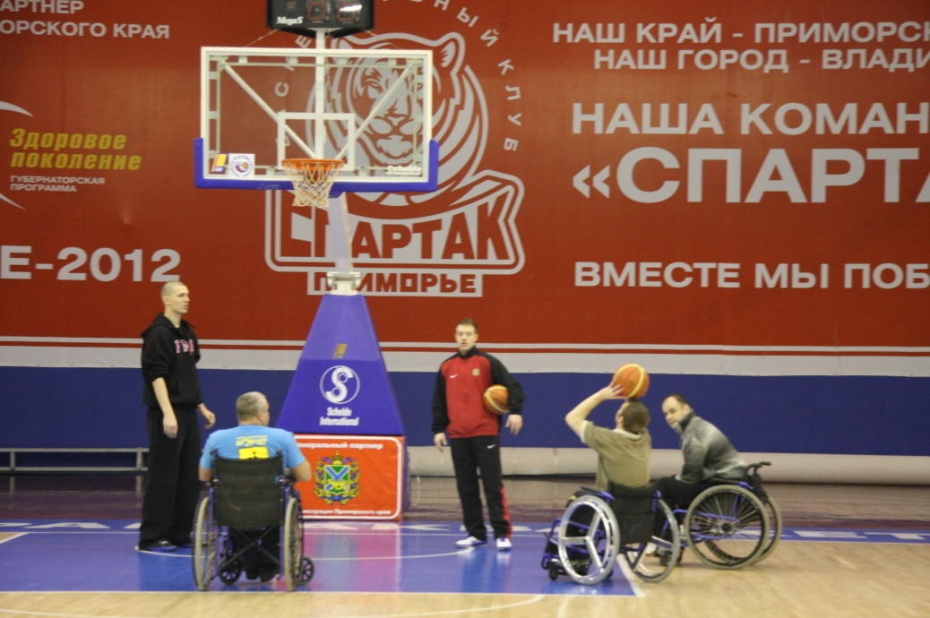
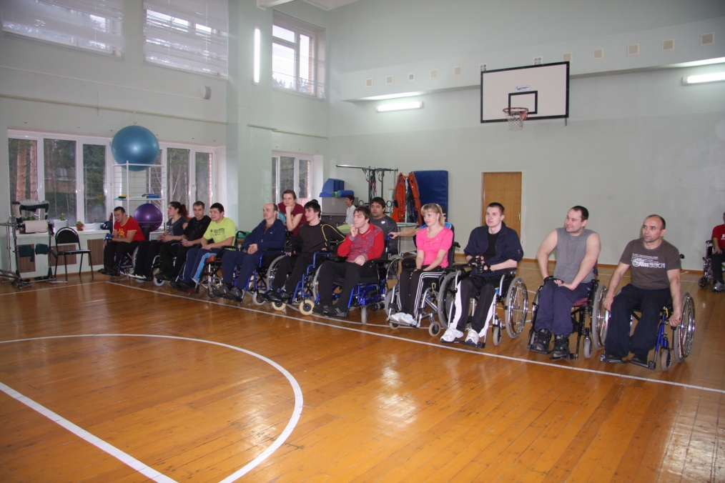
Sports of equal opportunities:
Sports events organized for physically-challenged people.

Slide 17
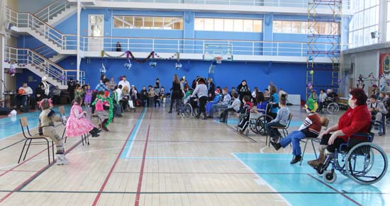
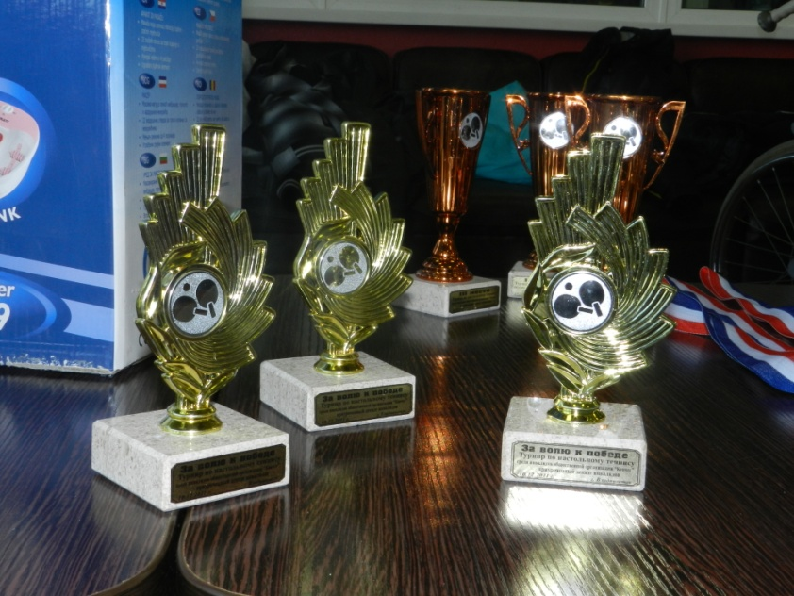

Slide 18
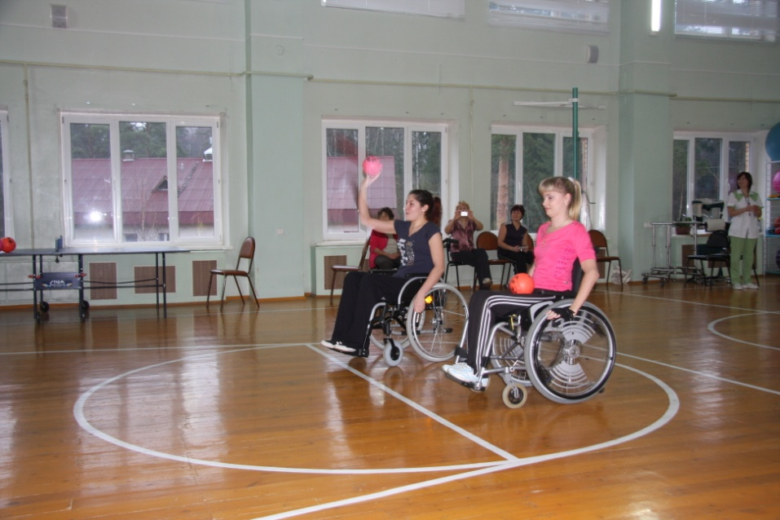
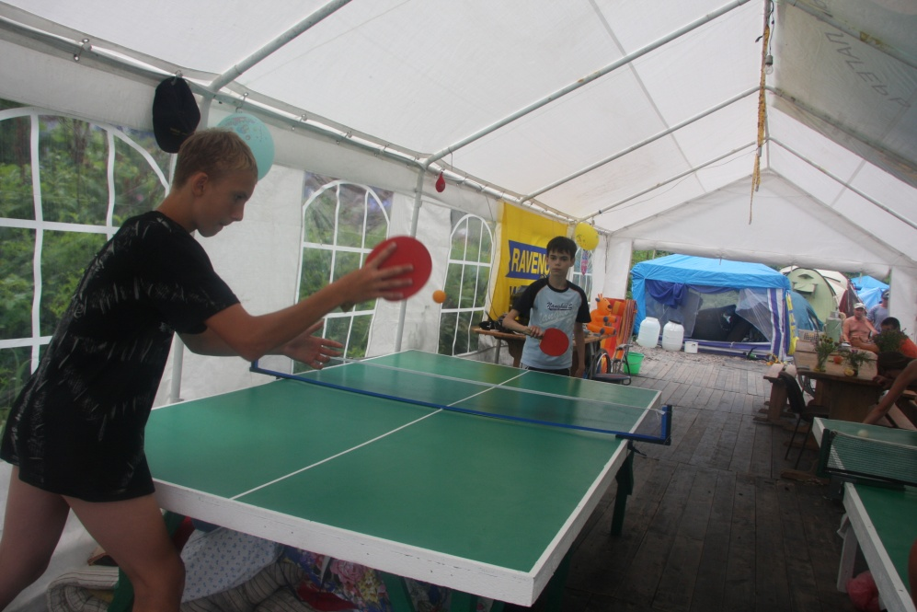

Slide 19
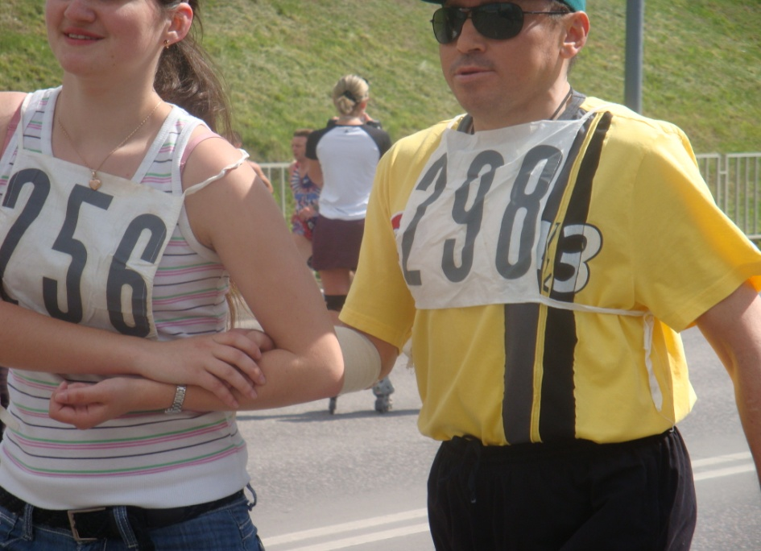
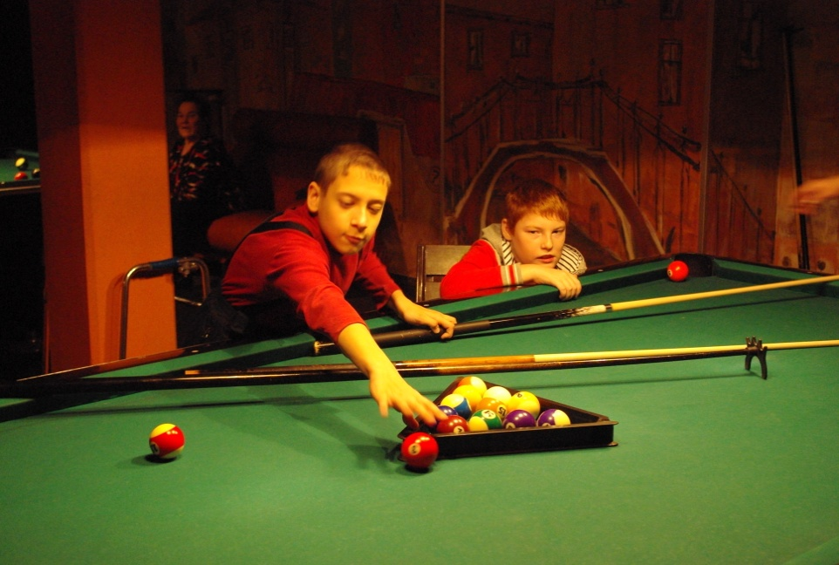

Slide 20
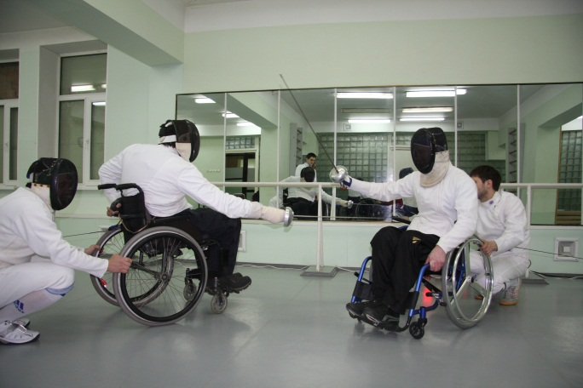
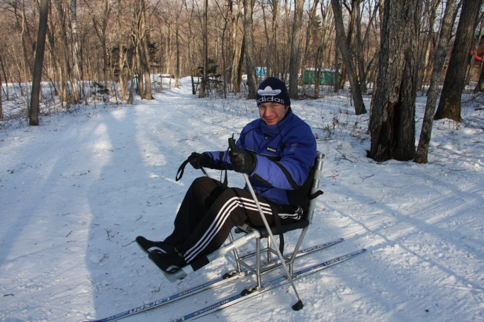
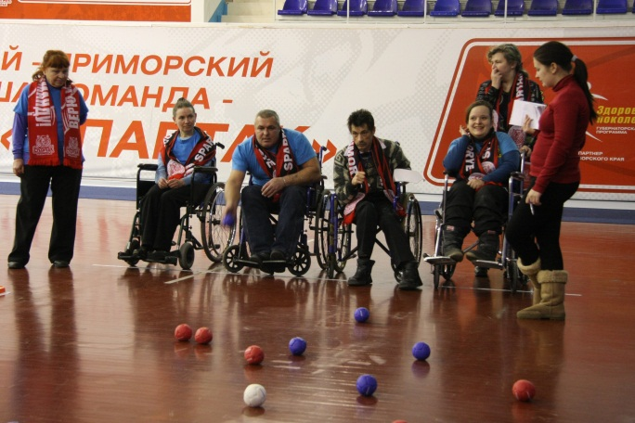
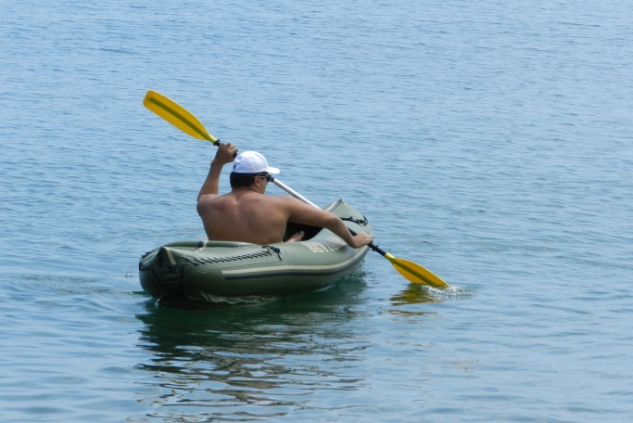
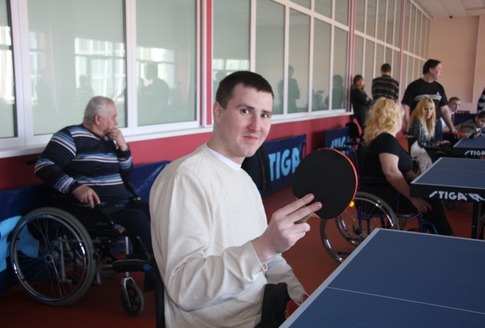
Major objectives of “Kovcheg”:
- Rehabilitation of people with disabilities through sports;
- Promotion of paralympic and other kinds of sports.

Slide 21
Major projects of the organization:
Construction of a rehabilitation center for people with disabilities of the Primorsky krai province;
Construction of a business center for people with disabilities on the territory of Vladivostok;
Development of sports of persons with disabilities;
Greater social adaptation and involvement of people with disabilities into the daily life of a community.

Slide 22
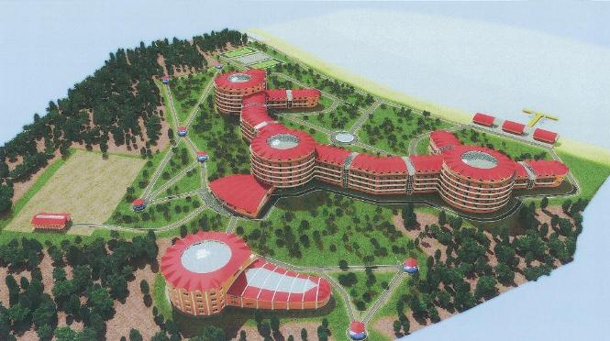
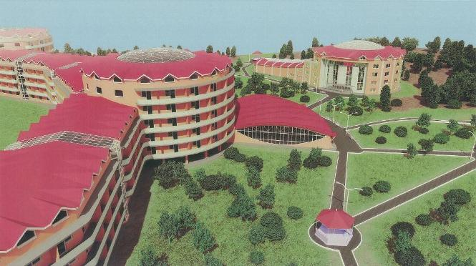
Rehabilitation center
Objective: to create an institution on a territory of the Primorsky krai province where people who were traumatized would have an opportunity to improve their health and to bring their psychological condition to balance in a proper time and in a high quality manner.

Slide 23
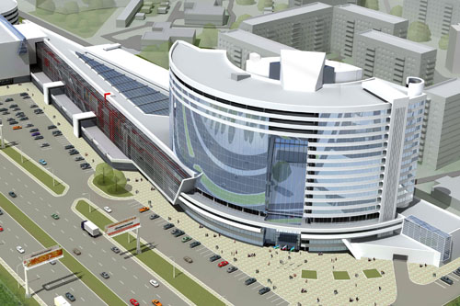
A specialized business center
Objectives:
To create all needed conditions that would help improve a social adaptation of people with disabilities;
- To improve a number employment opportunities of people with disabilities;
To create special conditions of employment of people with disabilities in different spheres of life.

Slide 24
Together we will be able to improve the lives of people with disabilities for good!

